Slide 1
NAAN MUDHALVAN-
DIGITAL MARKETING
Website Creation Using Wix.com
Team members:
Sharafath Hussain J( 2020308031)
Sara Nasrin S (2020308030)
Nikita Rajakumar (2020308026)
Nehasri S R ( 2020308025)
Nakulan A ( 2020308024)

Slide 2
Creating a Website in Wix.com for Jass Roasters Inc.
This presentation will help you effectively communicate the process of creating a website for Jass Roasters Inc. using Wix.com and outline the advantages and disadvantages of such an endeavor. The presentation includes introduction, information on the company, steps to create a website, advantages and disadvantages of creating a website, and a conclusion.

Slide 3

Creating a Website in Wix.com for Jass Roasters Inc.
Empowering Your Business Online
Creating a strong online network

Slide 4
Introduction
Jass Roasters Inc. is a renowned coffee roasting company, known for its premium coffee products and unwavering commitment to quality.
In today's digital age, an online presence is essential for businesses. Consumers increasingly rely on the internet to discover, assess, and connect with brands.
The goal of this presentation is to guide you through the process of creating a website for Jass Roasters Inc. using Wix.com. We'll also discuss the advantages and disadvantages of establishing an online presence, crucial for staying competitive in the modern business landscape.

Slide 5
Our Company
Jass Roasters Inc. derives its name from a combination of "Java" and "Roasters." The term "Java" is often used as a colloquial reference for coffee, while "Roasters" signifies the company's core business of coffee roasting. The name signifies a dedication to the art and science of coffee roasting. A tagline or slogan for the company might be: "Crafting Coffee Excellence" to convey the company's commitment to producing high-quality, artisanal coffee products. This tagline encapsulates the essence of Jass Roasters Inc., emphasizing their artisanal approach to coffee production.

Slide 6
Jass Roasters Inc. - A Product-Based Company
Certainly, here's a concise list of Jass Roasters Inc.'s coffee products:
1. Single-Origin Coffees
2. Blended Coffees
3. Espresso Blends
4. Flavored Coffees
5. Decaffeinated Coffees
6. Coffee Accessories
Target Audience: Jass Roasters Inc.'s products cater to coffee enthusiasts, cafes, restaurants, and individuals who appreciate high-quality, artisanal coffee. The target audience includes both connoisseurs looking for unique coffee experiences and those seeking everyday coffee options with exceptional taste.

Slide 7
Creating Your Online Presence
Stepby-step guide for creating a website using Wix.com:
1. Sign up for a Wix.com account.
2. Choose a website template.
3. Customize the website's design and layout.
4. Add content, including text, images, and videos.
5. Optimize for mobile and search engines.
6. Connect a custom domain.
7. Set up ecommerce features (if applicable).

Slide 8
Advantages of Creating a Website
Highlight the benefits of having a website for Jass Roasters Inc.:
Increased online visibility
24/7 accessibility for customers
Showcasing products and services
Building credibility and trust
Expanding market reach
Easy customer communication

Slide 9
Disadvantages of Creating a Website
Initial time and effort required
Maintenance and updates
Competition in the online space
Technical issues and security concerns

Slide 10
Solutions to Mitigate the Disadvantages of Creating a Website
It's important to remember that the disadvantages of creating a website can be mitigated by implementing the following strategies:
Use website builders to cut down on initial time and effort
Regularly update and maintain website to avoid technical issues and stay ahead of the competition
Conduct regular security checks to protect against breaches and cyber attacks

Slide 11
Conclusion
1. **Introduction**: Jass Roasters Inc., a premium coffee roasting company.
2. **Online Presence Importance**: The digital age requires businesses to have an online presence for brand visibility.
3. **Goal**: To guide through creating a website using Wix.com and discuss pros and cons.
Encouragement:
We encourage all businesses to consider establishing an online presence to remain competitive and accessible to modern consumers.

Slide 12
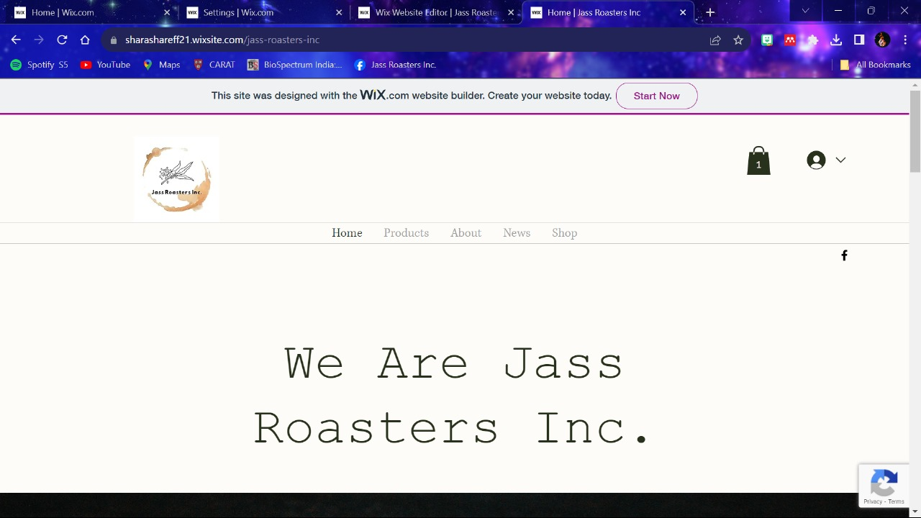
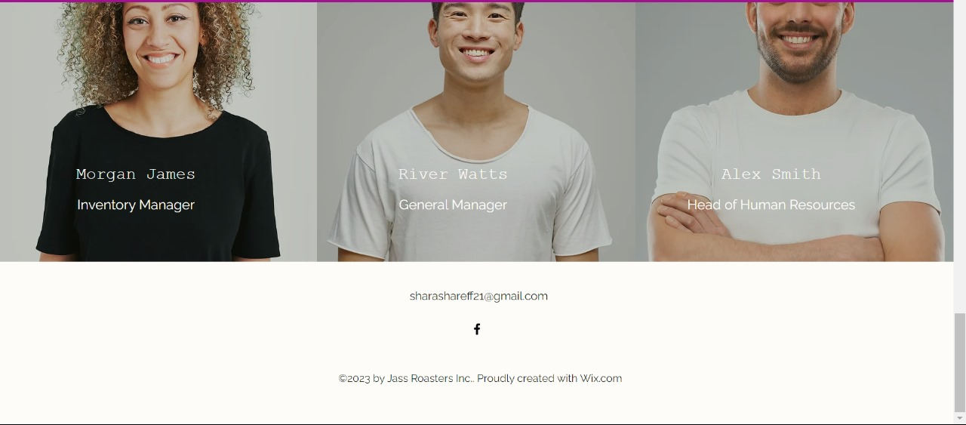

Slide 13
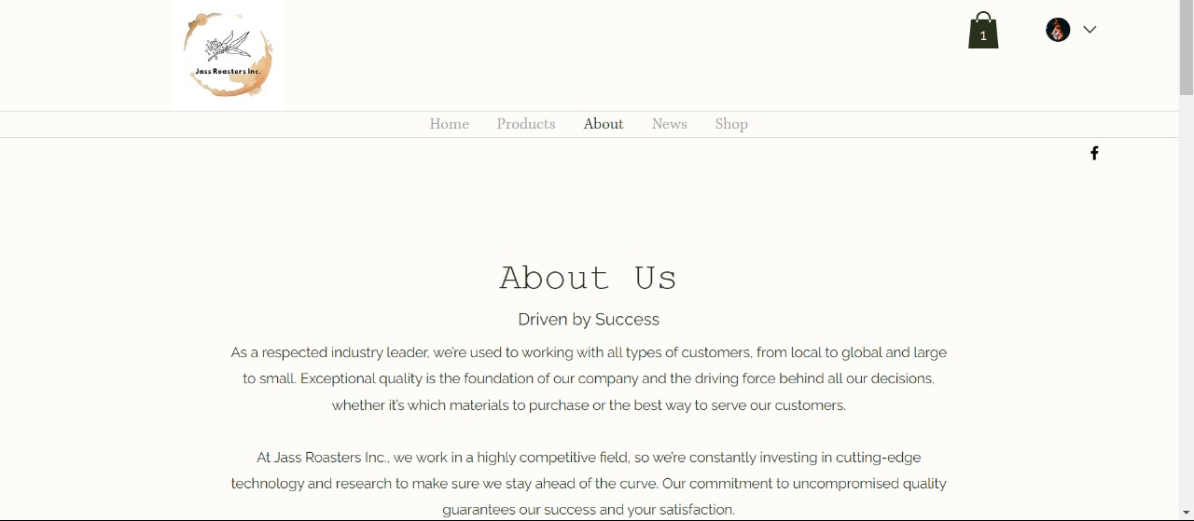
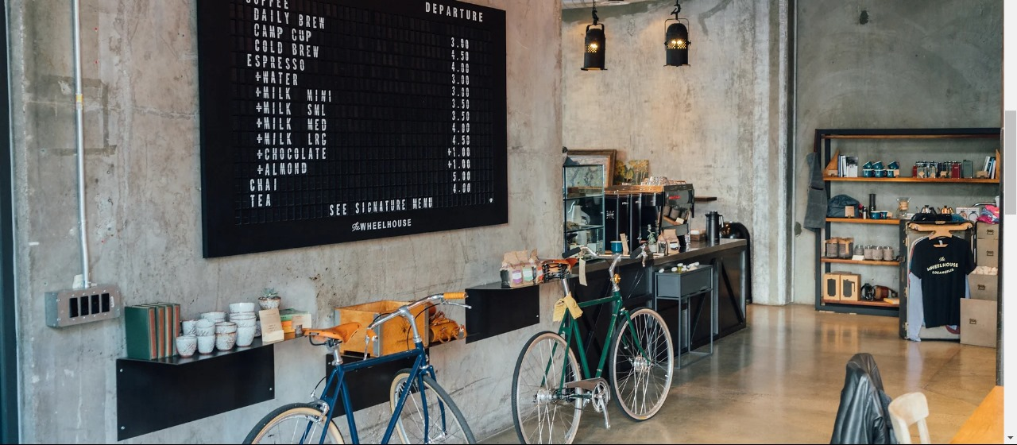
Website URL: Home | Jass Roasters Inc (sharashareff21.wixsite.com)

Slide 14
Thank you for your time 😊

